Slide 1
Policing Equity in Carrboro 2020 Q4
Update on efforts towards bias free policing

Slide 2
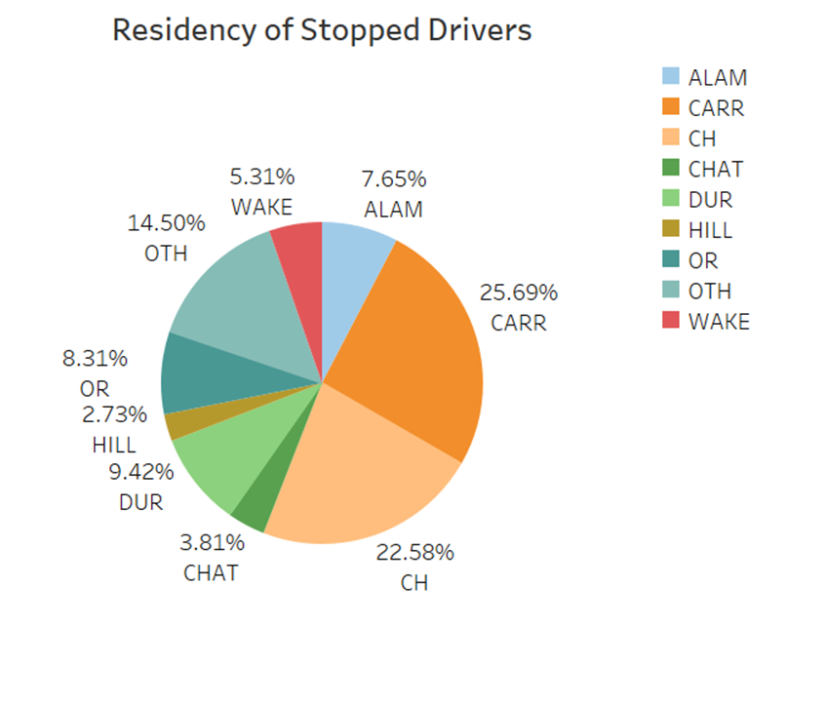
Residency Tracking 2019
Weighted Population
White 62.49037
Black 18.36172
Asian 7.39882
Hispanic 8.96115
Other 2.78794
The above chart is the estimated demographics of Carrboro drivers, based on area of residence of stopped drivers.
Notes:
We continue to track the place of residence of those stopped for traffic violations in Carrboro. Based on this, we see that we cannot compare demographics of all traffic stops to that of the town. While there is no perfect population to compare against, we believe that the weighted population offered is a better model for the demographics of those driving in Carrboro than the town population. Here, the residence status of all drivers stopped in 2019 is shown to give us a better comparison for the 2020 data.

Slide 3
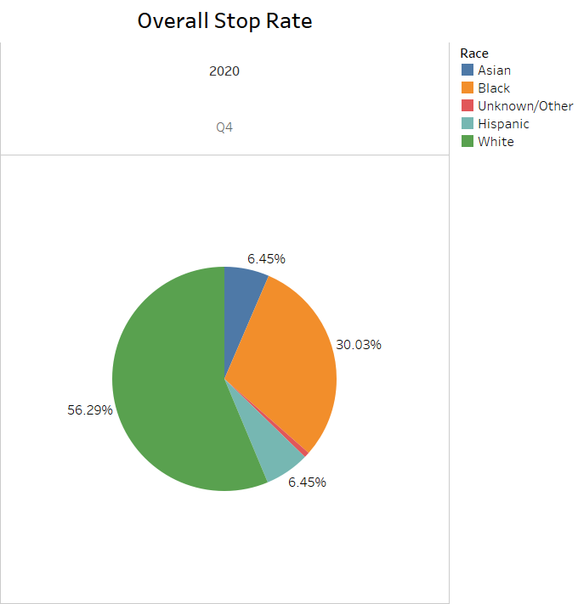

Overall Stop Rate 2020 Q4

Slide 4
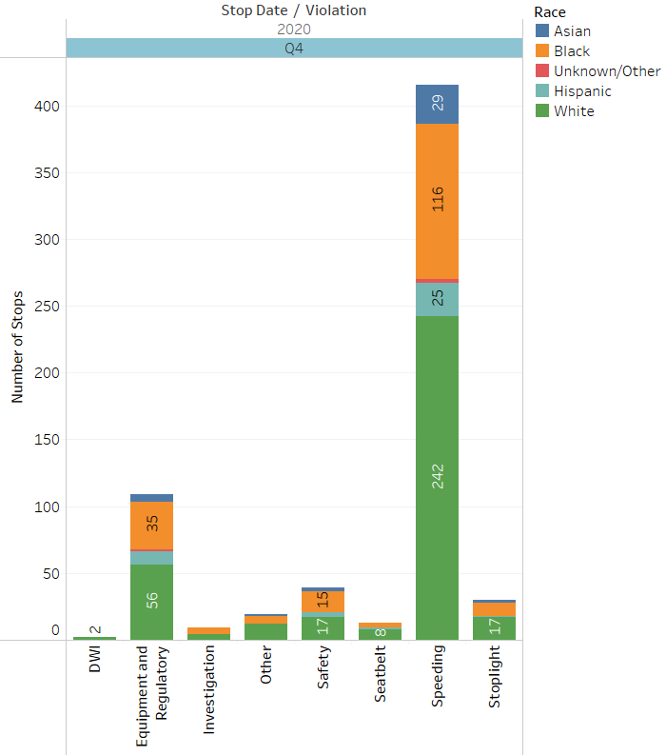
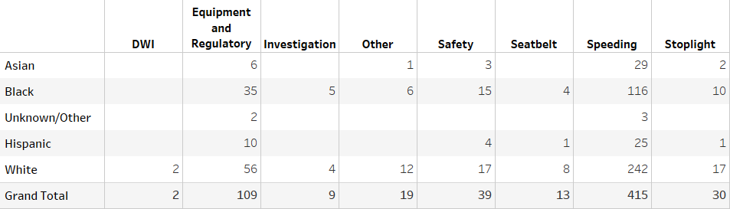
Reason for Stop
Notes:
This slide shows the five year comparison of the reason for stop. On our Traffic Stop report the reason for stop are Checkpoint, DWI, Investigation, Other MV violation, Safe Movement, Seat belt, Speeding, Stoplight/Sign, Equipment and regulatory , which we combined.
Note we only participate in DWI checkpoints hosted by other agencies outside of Carrboro. The last one we participated in was in 2016
Speeding is the most frequent reason for stops followed by equipment and regulatory.

Slide 5
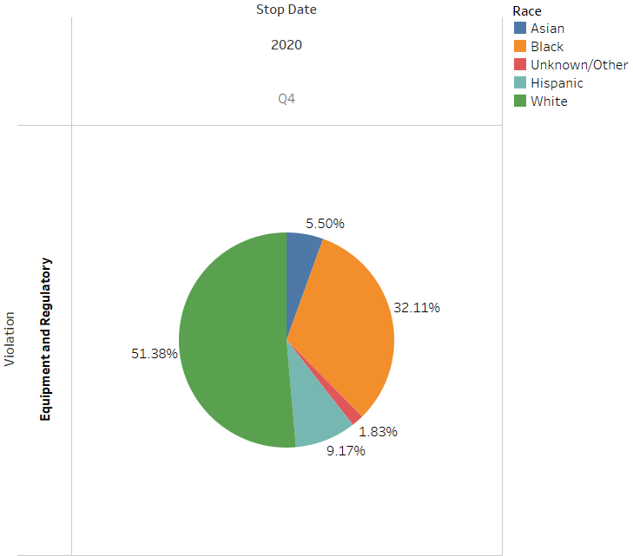
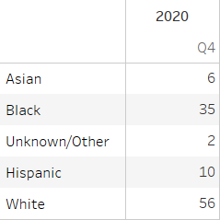
Equipment and Regulatory Violations
Notes:
One area we were trying to focus on was equipment and regulatory stops not being a priority. A Directive was issued in December of 2015, advising officers that these violations are not priority and to warn if possible.

Slide 6
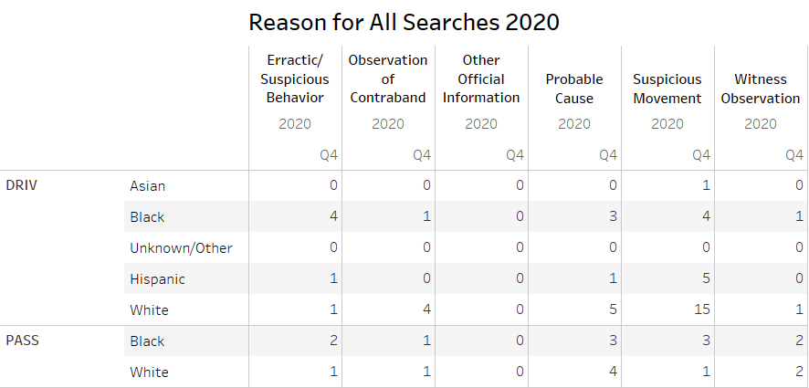
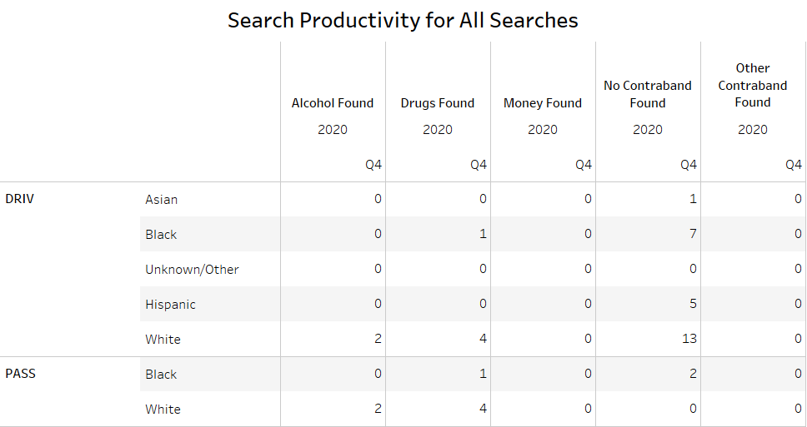
Types of Searches and Search Productivity
Notes:
Number of all search types; search productivity for all search types.

Slide 7
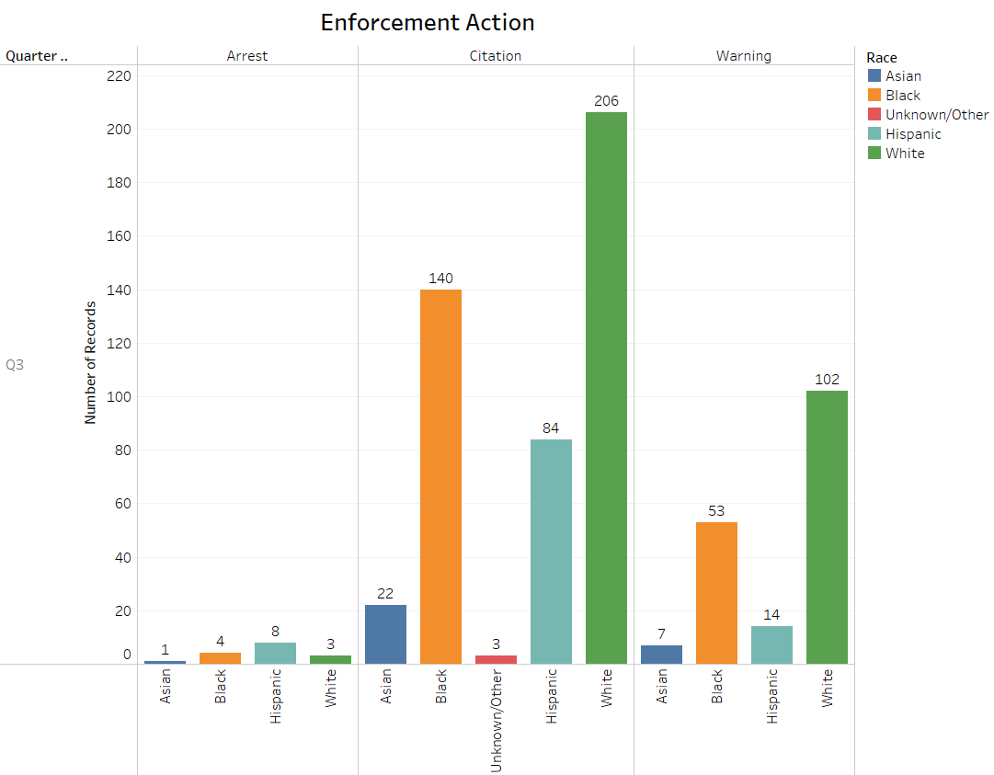
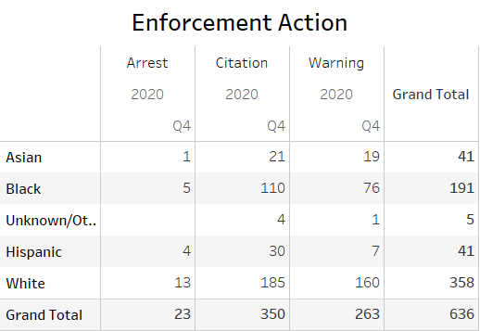
Enforcement Action 2020 Q4

Slide 8
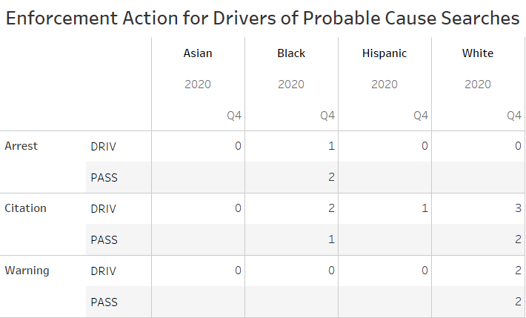
Probable Cause Searches
Notes:
Here is a break down of the enforcement action taken on probable cause searches

Slide 9
Use of Force
Seven use of force incidents in 2020 Q4. This is atypical (more typical is 1-4).
Suspects involved: 3 white male, 3 black male, 1 black female

Slide 10
Citizen Complaints
Only 1 citizen complaint in 2020 Q4.
Nature: Other; Resolution: Unfounded

