Slide 1
2025 Race and Equity Wins
February 6, 2026
Presented by the Race & Equity Team

Slide 2
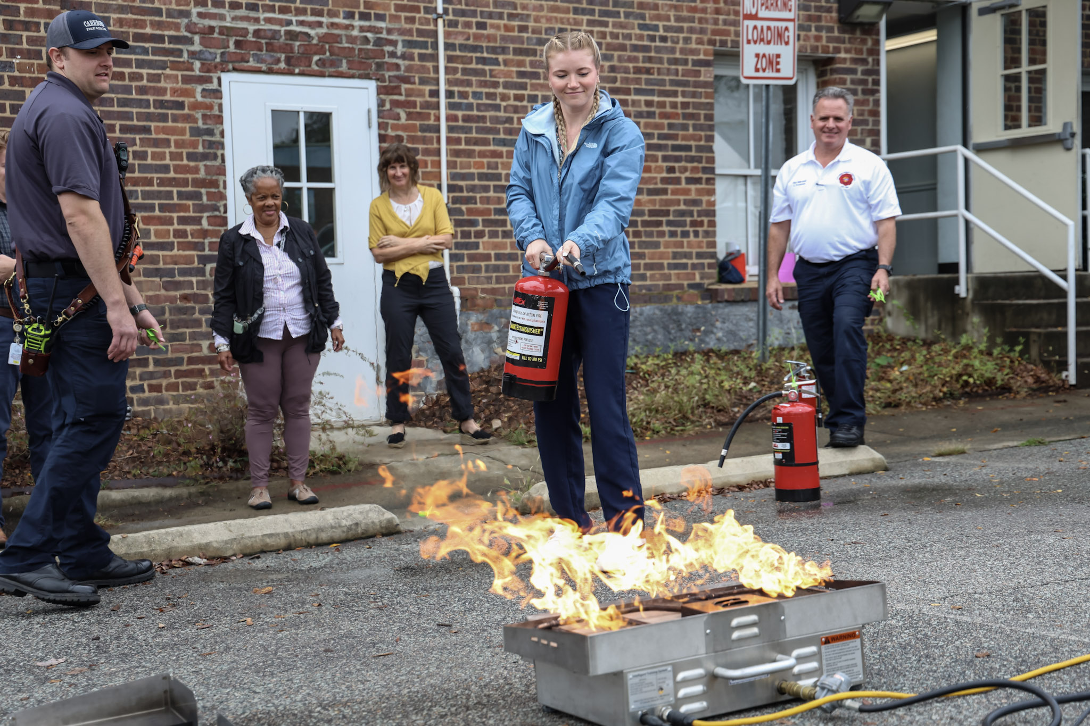
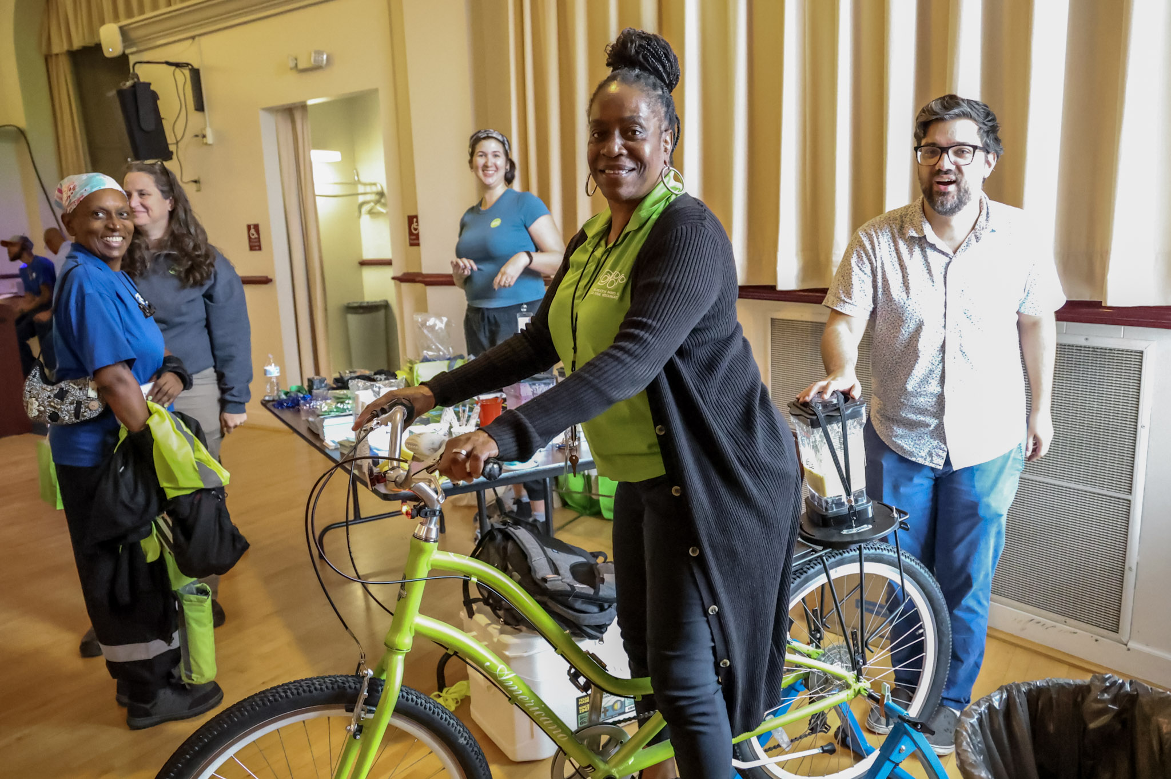
Human Resources
Over the past year, the HR Team advanced the Town’s commitment to equity by strengthening inclusive hiring practices, supporting employee wellbeing, increasing access to information, and fostering a workplace culture where all employees feel valued and respected. Our focus is to make the Town a place where people with different backgrounds and needs can show up, feel supported, and succeed, and where we actively address barriers when they arise.
Expanded representation and access-recruitment
Participation in job fairs and professional networks, including NC Works, Coastal Plains, Handshake, GARE, and NCLM.
Broadened applicant pools and increased visibility as an inclusive municipal employer.
Total Hires Jul 2024-Jun 2025 |  | 63 | % | Total Hires Jul 2025-present | 13 | %
Caucasian | 40 |  | 63.49% |  | 10 | 76.92%
African American | 12 |  | 19.05% |  | 2 | 15.38%
Hispanic | 5 |  | 7.94% |  | 1 | 7.69%
Asian | 3 |  | 4.76% |  | 0 | 0.00%
Other | 2 |  | 3.17% |  | 0 | 0.00%
American Indian | 1 |  | 1.59% |  | 0 | 0.00%
 | 63 |  |  |  | 13
BIPOC | 23 |  | 36.51% |  | 3 | 23.08%

Slide 3
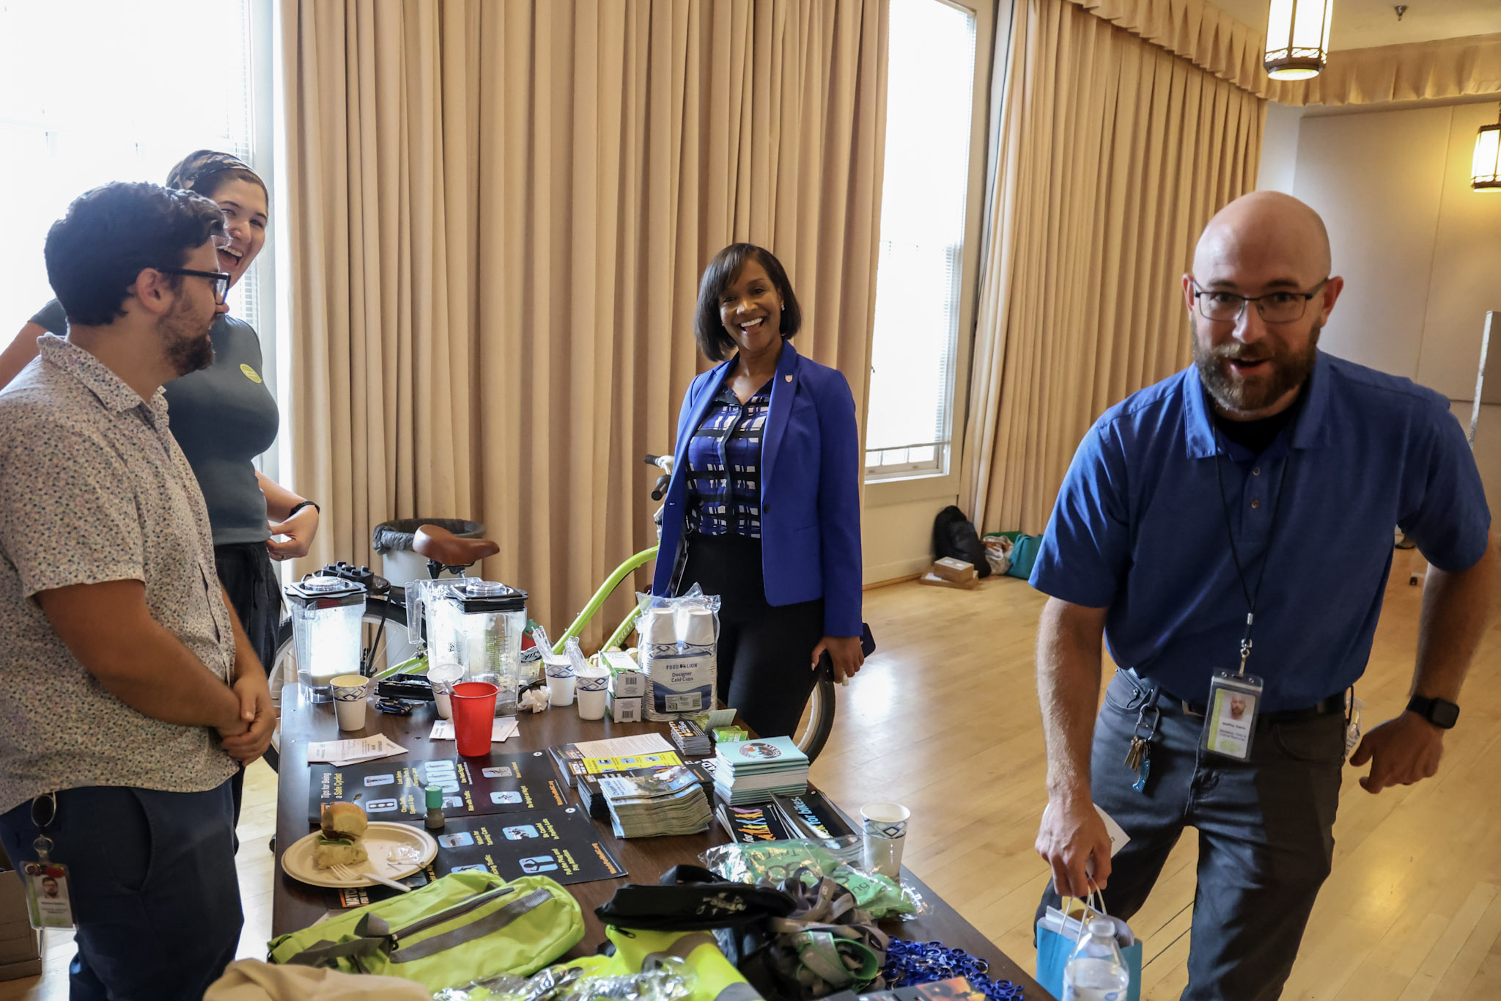
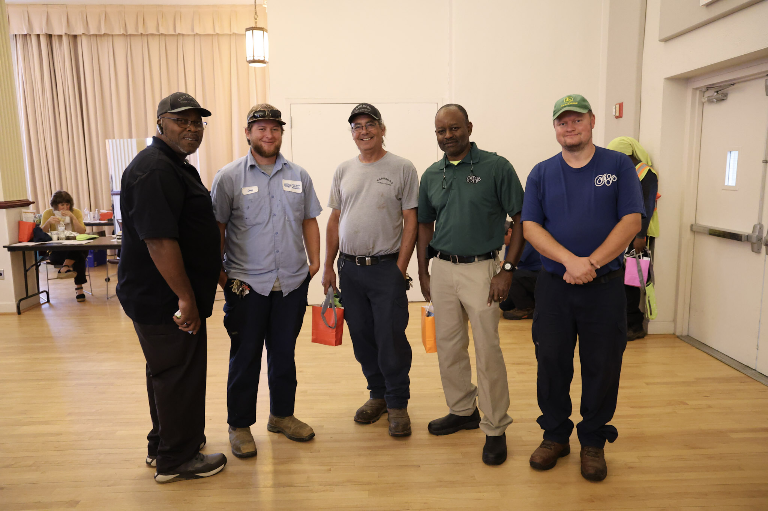
Human Resources
Employee-Friendly and Inclusive Workplace Practices
Hybrid and Flexible schedules for balancing personal and professional responsibilities.
Coordination of community-building events such as the Spring Picnic, Holiday Luncheon, Safety Fair, and Departmental Spotlights to increase awareness and appreciation across Town operations.
Cross-Functional Partnerships
HR partnered with the Planning Department to deliver Title VI training to reinforce nondiscrimination standards in public service. Over 130 staff participants, at most recent count.
HR partnered with the Communications and Engagement Department to launch the Bilingual/Multilingual Policy Program, expanding language access and supporting staff who serve residents in multiple languages.
Supported equitable leadership practices, particularly in guidance on performance, employee relations, and policy application, and offered training and educational opportunities through facilitation of Quarterly Supervisor Meetings.

Slide 4
Planning, Zoning & Inspections
Incorporated demographic activity at majority of events the department facilitated or participated in including Bike Month, Open Streets, Carrboro in Motion, Downtown Area Plan, New Unified Development Ordinance, and others. Total Events: approximately 25
Strategic outreach and participatory planning with Historically Black Neighborhoods for several ongoing town and private-sector projects (Downtown Area Plan, New UDO, OWASA expansion proposal, active development permits, overlay districts, and more).
Implementation of the Language Access Plan through incorporating translations services at key outreach and engagement events, and creation of Spanish language materials for various projects, inclusion of Spanish speaking consultant for Safe Routes to School engagement events.
Race and equity framing continued for projects like the Safe Routes to School, New Unified Development Ordinance, Reimagining Weaver Street, and the Downtown Area Plan.
Continued partnership with the Marian Cheek Jackson Center, El Centro Hispano, Habitat for Humanity, as well as new relationships with St. Paul’s AME and the Community School for People Under 6, and apartment complexes in Carrboro to build relationships with historically marginalized communities.
Continued collaboration with the Historic Rogers-Road Neighborhood for the Greene Tract Master Plan and the financial feasibility analysis being completed after adoption the plan.
Application to 2026 GARE Community Planning Cohort—in partnership with Housing and Community Services, Empowerment Inc., and Habitat for Humanity—to receive technical assistance around affordable housing and land use planning.
Updates to the Title VI Plan and continued work on the ADA Transition Plan
Progress towards the completion of REALs before the end of calendar year 2025
Waived permit fees for residents needing inspections and repairs after Tropical Storm Chantal
Supported disaster recovery and relief efforts with staff on site at the Drakeford and with mapping and GIS tools.

Slide 5
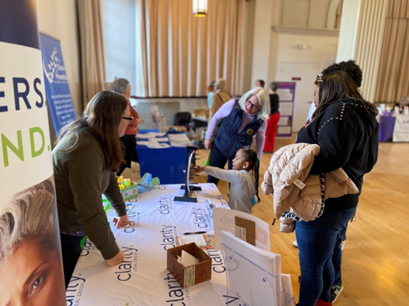
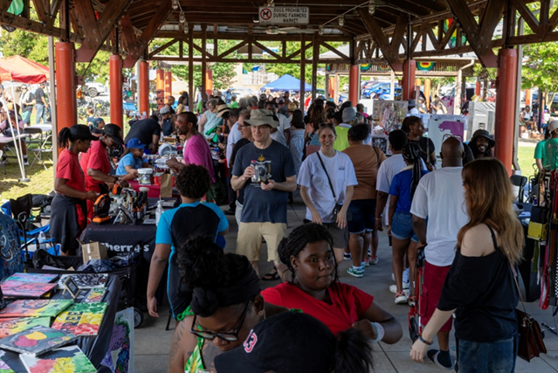
Recreation Parks & Cultural Resources
Community Events
Youth led Dr. Martin Luther King Jr. Event
Black History Month Events including RPCR lecture series and concert series
12th Annual Douglass Reading
Recreation Parks and Cultural Resources
Evaluation of current vendors and being intentional about local BIPOC businesses included in our selection processes
Providing a variety of food trucks, specifically food trucks that are owned and operated by black & brown individuals. This could be seen throughout all special events
Offered a Health & Wellness Fair which was aimed to attract a diverse audience.
Continued to offer the Mobile Play Unit Program during the summer to bring recreational activities to in the Brewer Lane and Lloyd/Broad communities
Provide transportation to and from the following local low-income senior living communities for several senior events/programs.
Completed replacement of Baldwin Park playground equipment with enhanced accessibility and inclusivity.
Partnered with North Carolina Central Men’s and Women’s Tennis Teams to promote tennis via the International Tennis Carnival.

Slide 6
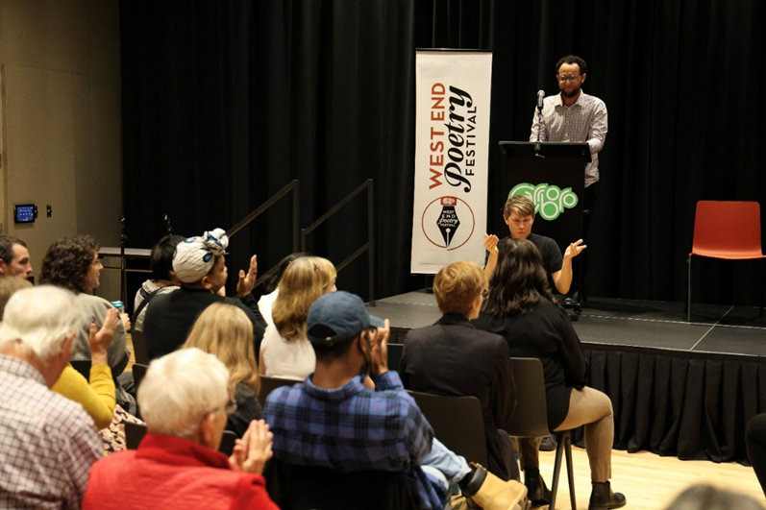
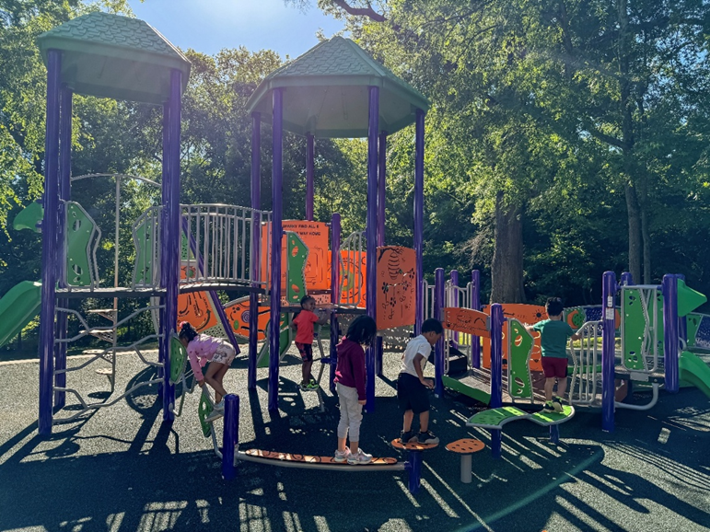
Recreation Parks & Cultural Resources
Hosted a BIPOC vendor fair as part of the Freight Train Blues Concert Series.
Hosted Carrboro-Chapel Hill Juneteenth Celebration at Town Commons for the first time.
West End Poetry Festival featured a diverse array of poets, including Meg Day. Meg Day is a deaf and genderqueer poet known for her impactful works that explore themes of identity, disability, and the intersection of language and experience. The department hired two American Sign Language (ASL) interpreters for the event.
Holding a new Kwanzaa celebration in December 2025.
Partnered with PORCH and local elementary schools for canned food drive during Annual Holiday Tree Lighting event.
Worked with Communications & Engagement and internal bilingual department staff on translation of department documents.
Partnered with The ReCYCLery to host their non-profit operations at Dr. Martin Luther King, Jr. Park as they continue their work to enhance bicycle transportation access for the community.
Revised fee structure to provide rental discounts for Carrboro Residents and to solidify process for certified non-profit organizations.

Slide 7
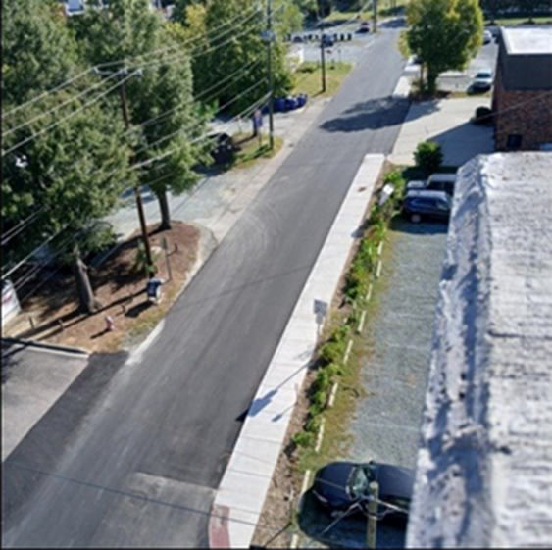
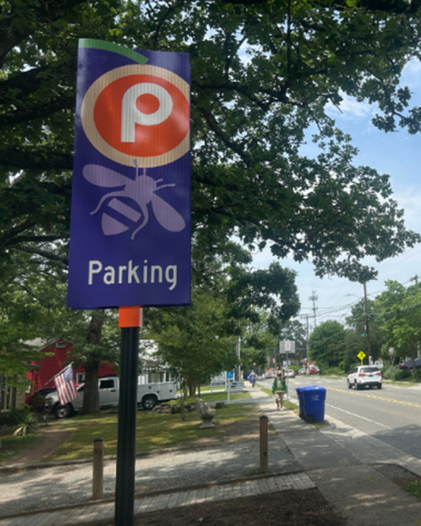
Public Works
Drakeford Library Complex: Construction completed, expanding access to educational and community resources.
Stormwater Residential Assistance Program: Supported homeowners with technical guidance and green infrastructure installations to improve stormwater management and landscape resilience.
2025 Street Surfacing Project:
Installed 230 feet of new sidewalk on Roberson Street.
Replaced 6 ADA curb ramps.
Painted new crosswalks and added green‑striped bike lanes.
Fidelity Street Improvements: Installed median island and crosswalk to reduce traffic speeds and enhance pedestrian safety; updated striping for pedestrian, bicycle, and vehicular safety.
Parking Wayfinding Signage: Installed directional signs downtown and at Town lots to improve accessibility for motorists and cyclists.
Fire Station 1 Drainage Project: Completed design and initiated contract for drainage improvements and bioretention cell installation. (TC Contract Approval on Nov. 18th).
Parks Enhancements: Assisted with installation of new playground at Baldwin Park and pump track at Dr. Martin Luther King Jr. Park.
Westwood Cemetery Master Plan: Continued development to diversify interment options and enhance property.
Workflow & Asset Tracking Software: Continue to monitor project locations and ensure equitable service delivery across neighborhoods.

Slide 8
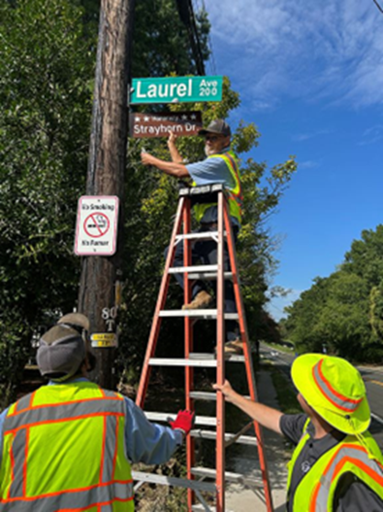
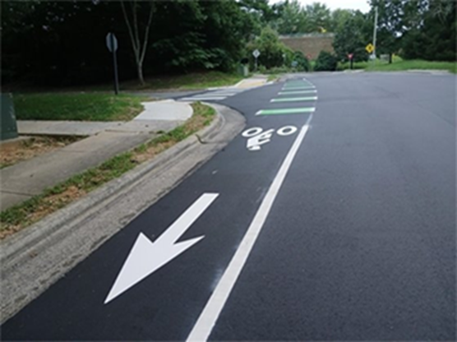
Public Works
Honorary Strayhorn Drive Sign: Installed to recognize community heritage.
Westwood Cemetery Master Plan: Continued development to diversify interment options and enhance property.
Workflow & Asset Tracking Software: Continue to monitor project locations and ensure equitable service delivery across neighborhoods.
Supported major community events including Fiestas en la Calle, Small Town Pride, Carrboro Music Festival, and local road races.
Maintained Town informational kiosks in underserved communities.
Assisted departments with messaging boards, banners, and flag displays representing diverse organizations.
Provided ongoing public education on Public Works services.
Completed Racial Equity Assessment Lens to guide decision‑making.
Assisted Planning Department with the ADA Transition Plan.
Encouraged minority participation in Town procurement activities.
Developed and implemented a Temporary Street Closing Policy, standardizing requirements and clarifying the permitting process. (TC Approval on Nov. 18th for Town Code Amendments).
Developed a new employee onboarding package to standardize processes and improve equity in workforce integration.

Slide 9
Public Works
Capital Projects/Engineering Division: Continued to oversee the design and delivery of capital projects with a focus on equity, sustainability, and community benefit.
Cemetery Management: Continued to provide equitable administration of cemetery services, including plot sales, plot markings, and monument markings.
Central Services: Continued to provide consistent upkeep of municipal buildings to ensure safe, functional, and equitable access for staff and residents.
Fleet Maintenance: Continued upkeep of Town fleet and equipment to support equitable service delivery across the community.
Solid Waste: Continued to ensure community members receive efficient and equitable collection; disposed of MSW in compliance with statutes and ordinances.
Streets & Grounds: Continued to maintain public streets, landscaped areas, and community grounds to ensure safe, accessible, and equitable environments.
Stormwater Utility: Continued to manage stormwater systems to reduce flooding risks, improve water quality, and provide equitable protection across neighborhoods.
Supervision: Continued to ensure construction projects are delivered on time and within budget, while providing equitable oversight and services that meet the needs of all community members.
Heather M.H. Holley, Stormwater Specialist, has been selected as a 2025–2026 STEM Educators for Equity and Diversity (S.E.E.D.) Fellow.
Ben Lang, Streets & Grounds Crew Leader, successfully completed the Carrboro Skills Test/Assessment and is now officially authorized to provide direct services to limited English proficient (LEP) residents, vendors, employees, and community partners.

Slide 10
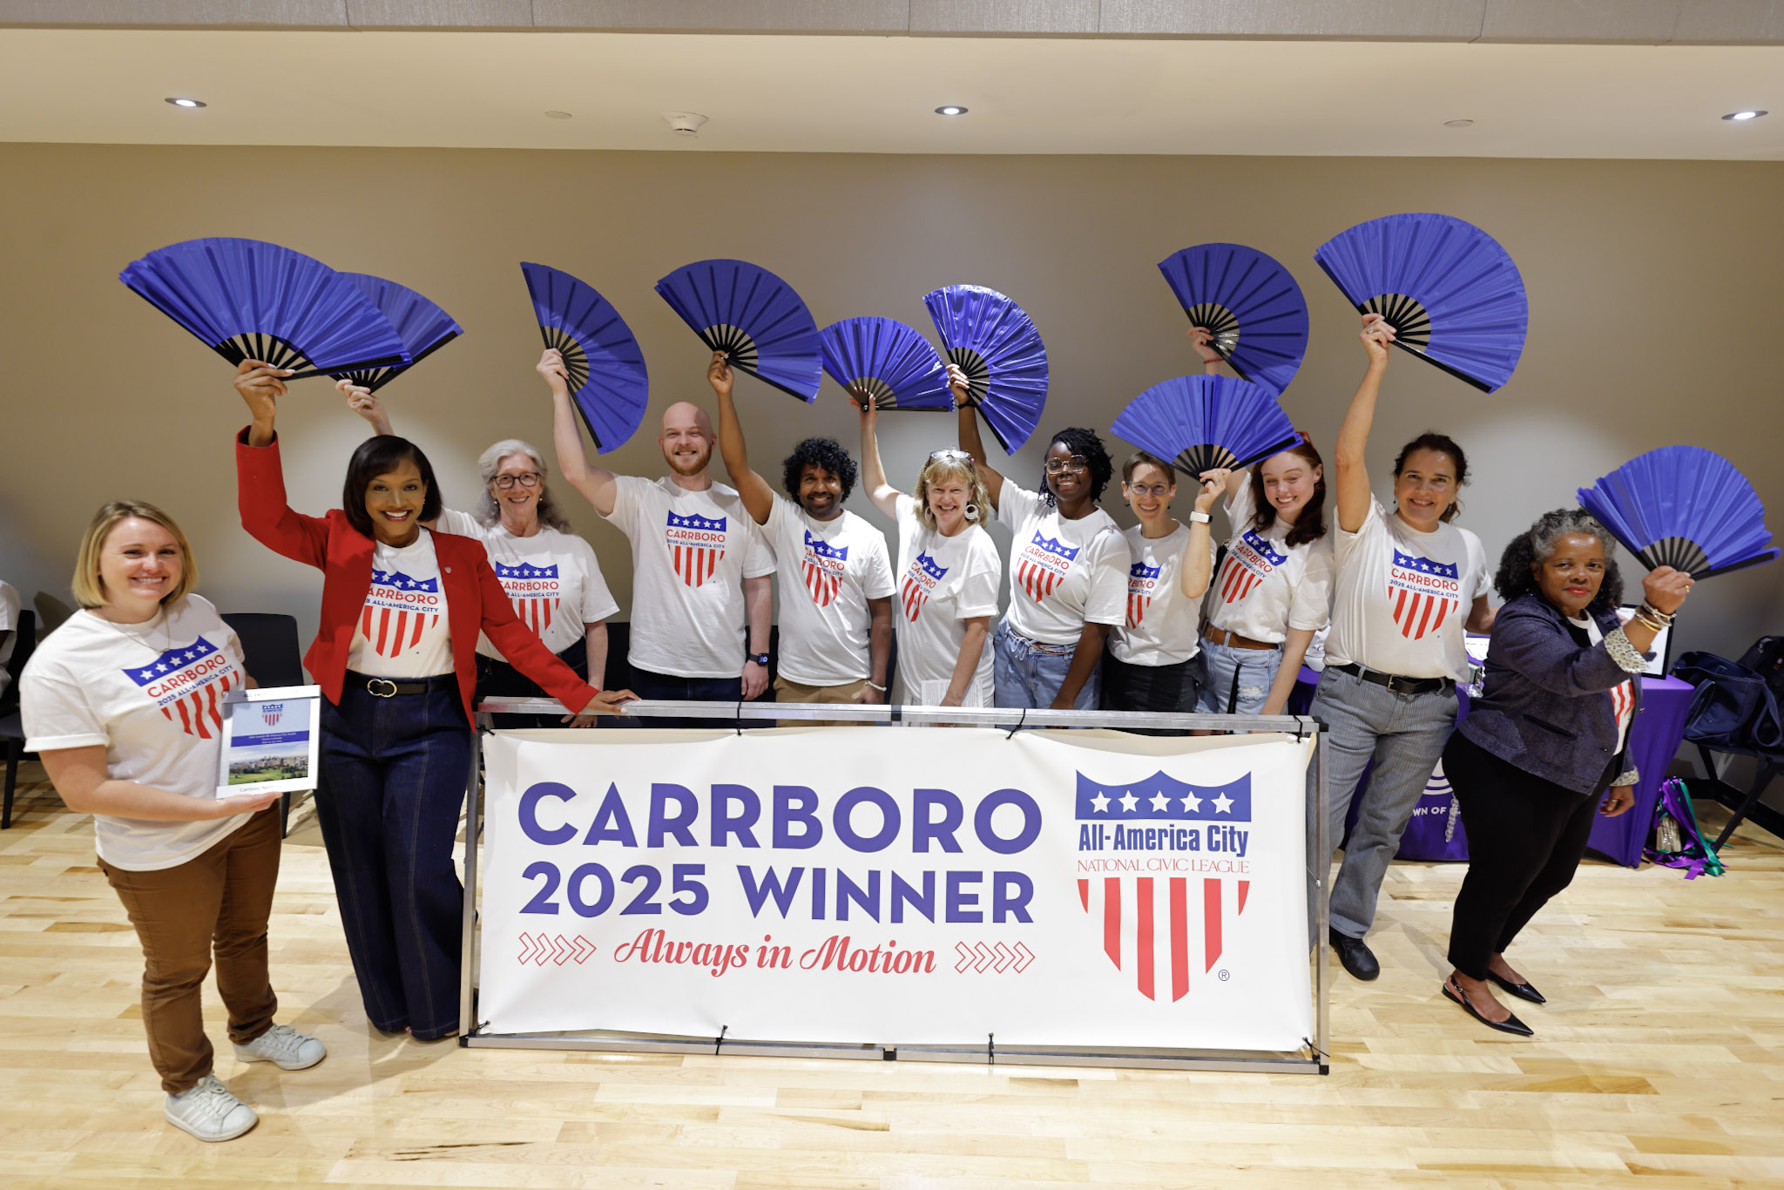
Communications & Engagement
Implementation of the Language Access Plan - public facilities managed by Town of Carrboro. Additionally, C&E facilitated the translation of more than 50 vital documents from across Town Departments.
Bilingual/Multilingual Staff Evaluation and Compensation Policy – A policy to drafted by C&E and the Human Resources Department to implement a $1,250 annual stipend to qualifying employees was approved in July 2025
IAP2 Certifications
Town Wall Calendar –bilingual (English/Spanish) wall calendar for the third consecutive year. staff team hand-delivered 2,500 calendars
All American City Award - C&E staff prepared the Town’s application including documentation of our organization’s achievements that led to Carrboro’s recognition as a 2025 All-America City by the National Civic League, marking a historic win in the town’s first year applying and competing for the prestigious national recognition.

Slide 11
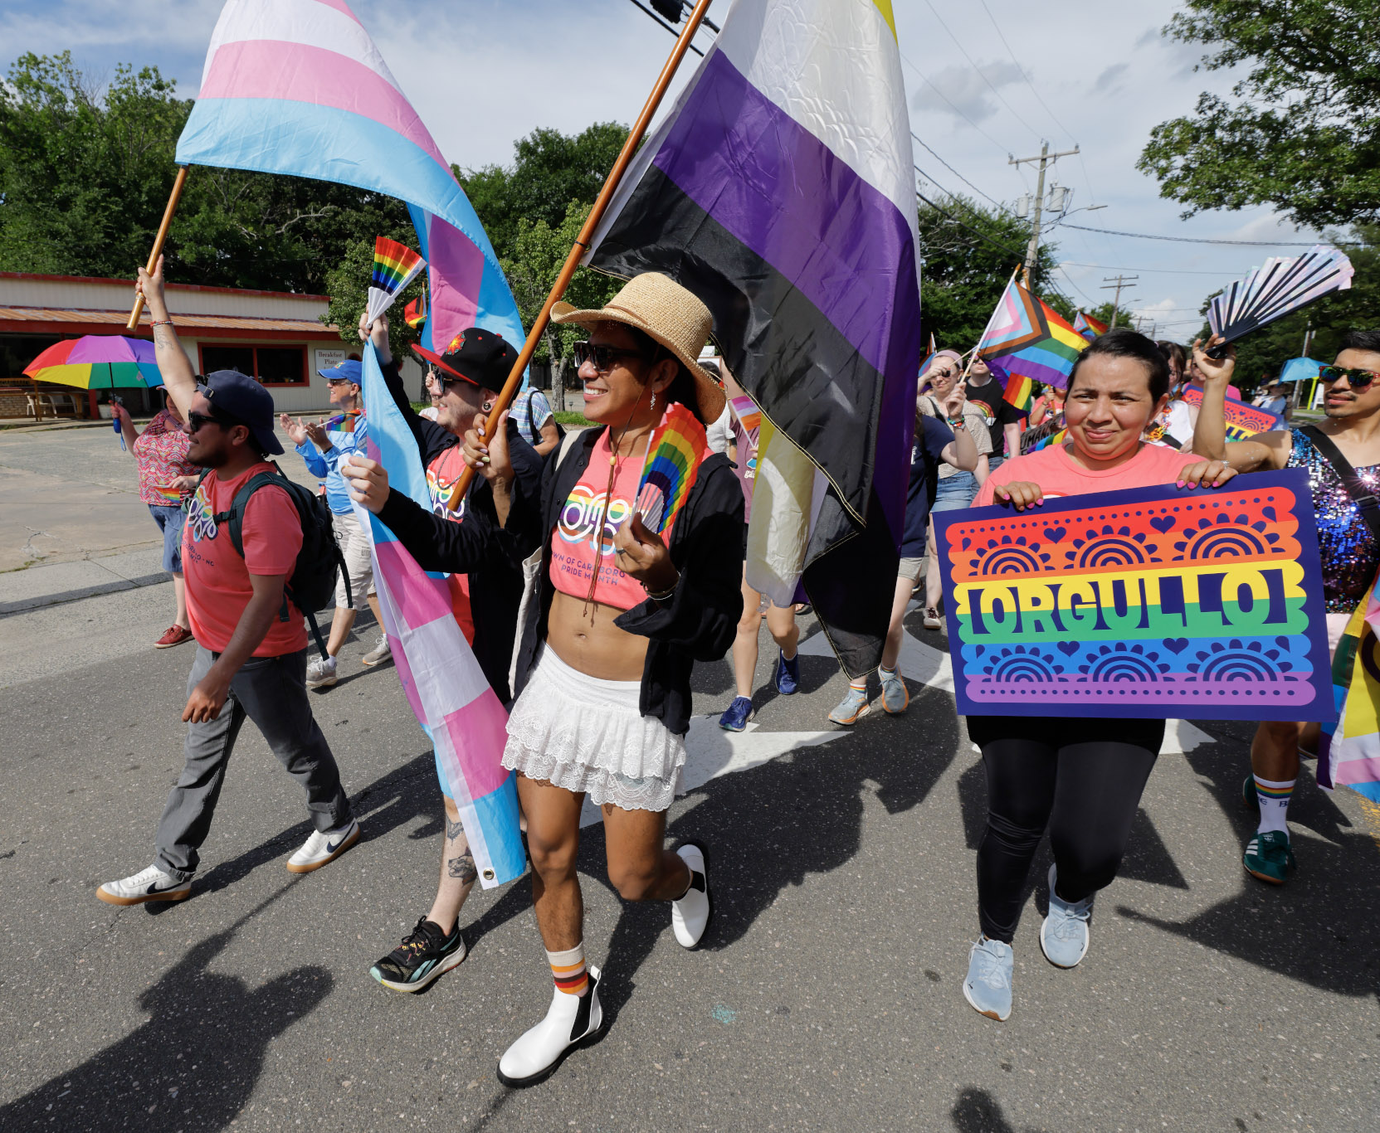
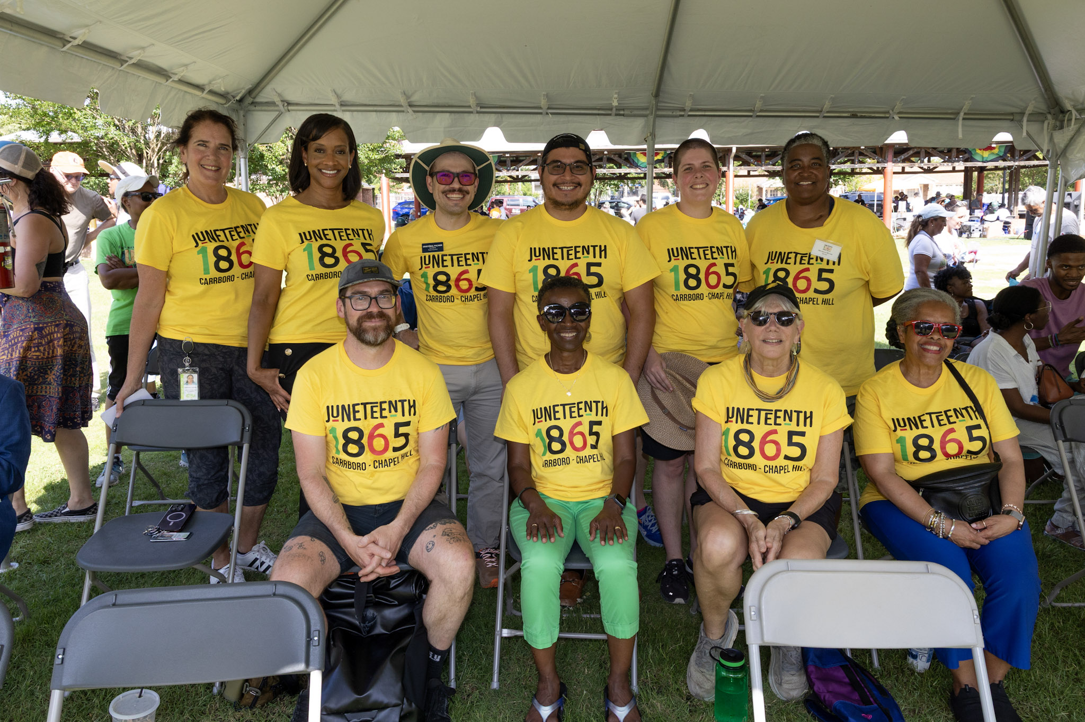
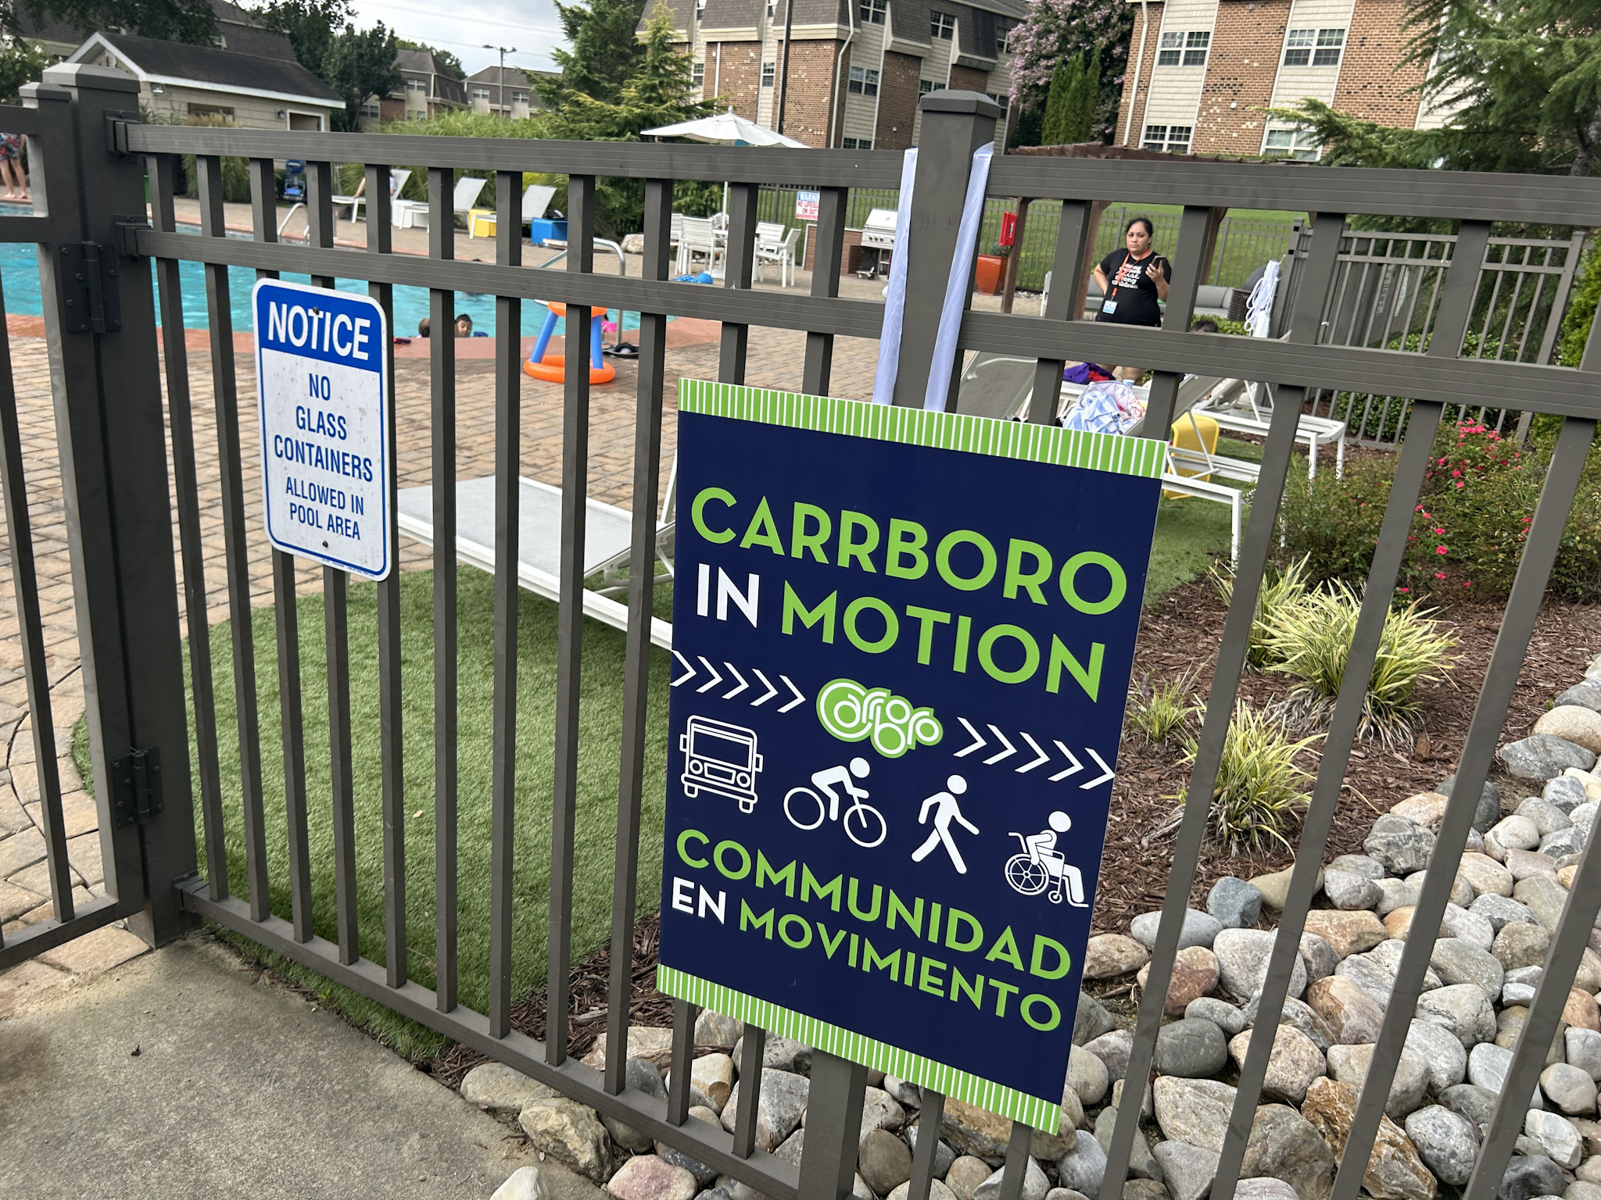
Communications & Engagement
Elizabeth Cotten Birthday Celebration (with music by her descendants)
Youth led Dr. Martin Luther King Jr. Event
Black History Month Events
Dedication of Drakeford Library Complex honoring Carrboro’s first Black mayor
Town Hall - First Race Equity-focused Town Hall which yielded a large crowd of highly engaged residents who made meaningful contributions to the conversation on topics affecting local government.
Juneteenth Celebration in Carrboro
Pride Piper Walk and Orgullo Pride Carrboro Celebration
12th Annual Douglass Reading
Unveiling of Honorary Strayhorn Drive
Fiestas en la Calle on Weaver Street in Carrboro
Braxton Foushee Day of Service

Slide 12
Housing & Community Services
Free Weatherization Program - Door to door engagement strategy continues in 2025 to ensure lower-income homeowners, many of whom are elderly, Black long-time homeowners, are aware of this program. Engagement strategy includes in-person application assistance if needed. This direct and personal engagement is proving successful, increasing participating households by 175%. Currently, 11 households are participating with weatherization/repairs averaging $23,000 per household.
Homebuying Counselors Convening – Convened local, nonprofit homebuying counselors three times in 2025 with the goal of creating collaborative goals to increase access to first-time homebuyer education and access in Carrboro.
Ranking Human Services Funding Applications for Equity – Created ranking and recommendation system, based on: (1) Application Score; (2) Equity Score; (3) # Individuals Served; (4) # BIPOC individuals served; (5) Cost Per Person. Thirty-nine nonprofits were awarded $457,536 for FY26.

Slide 13
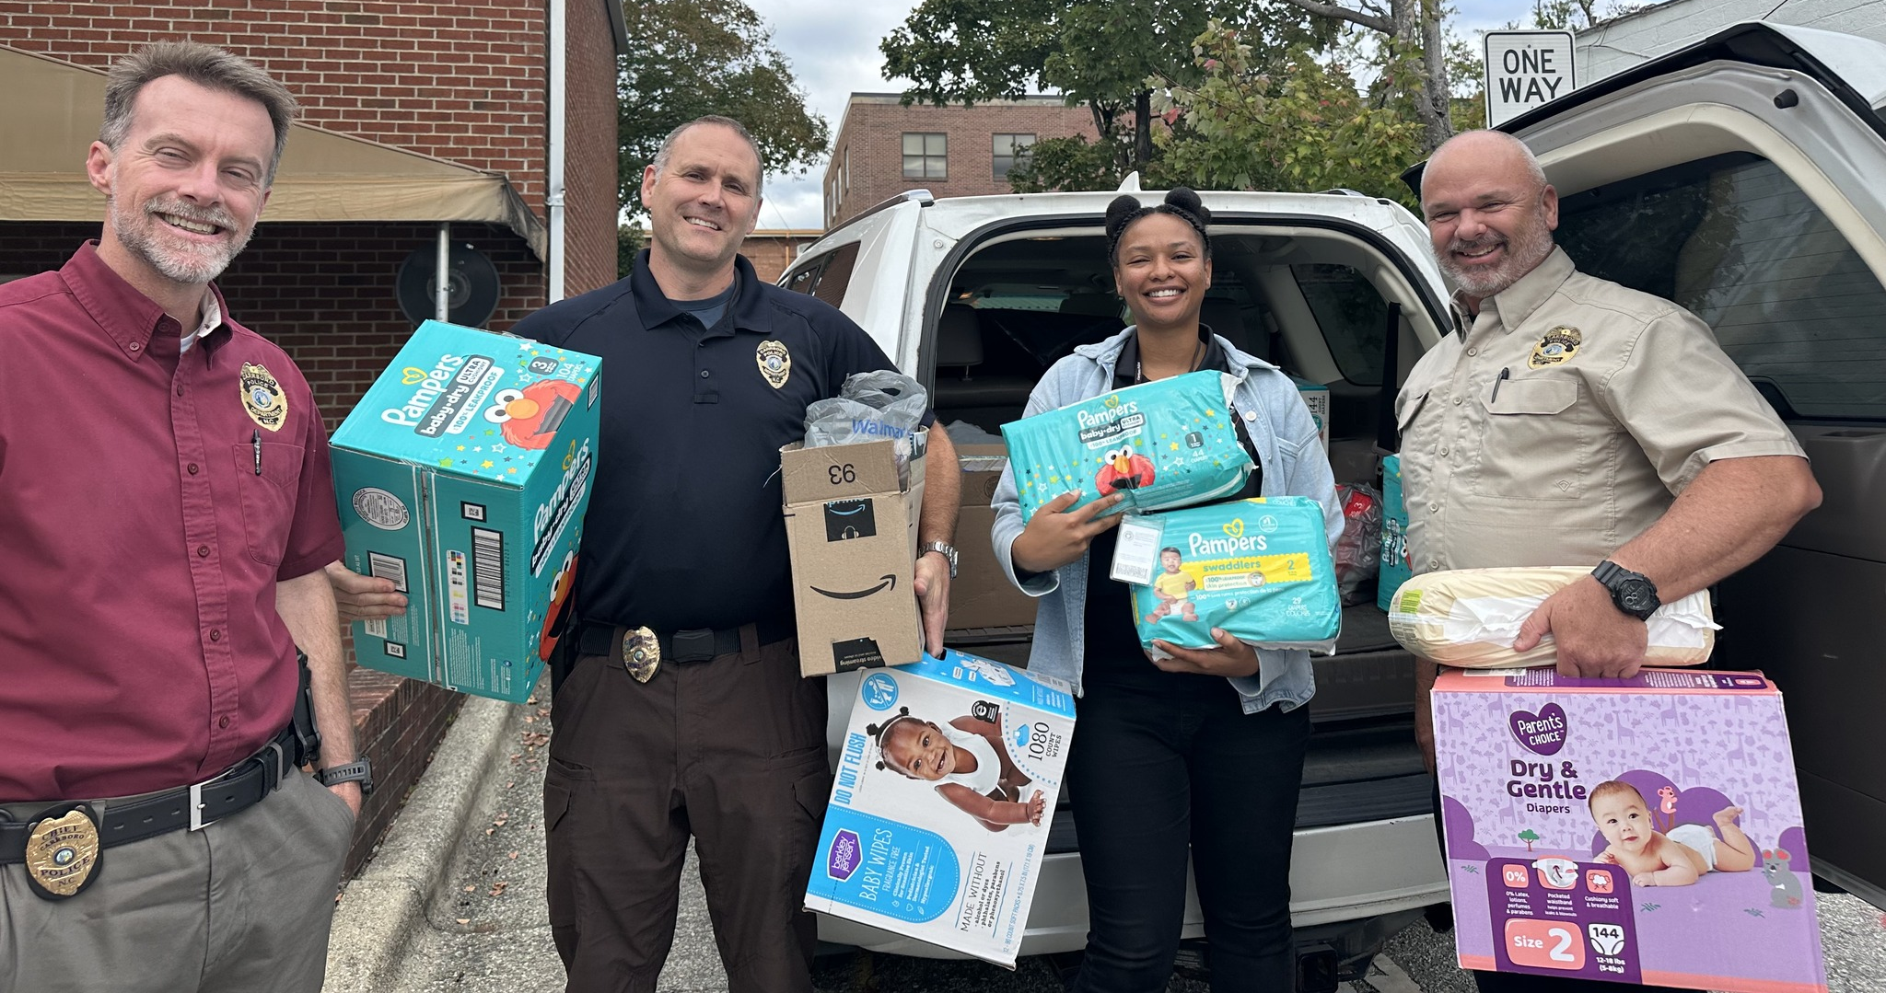
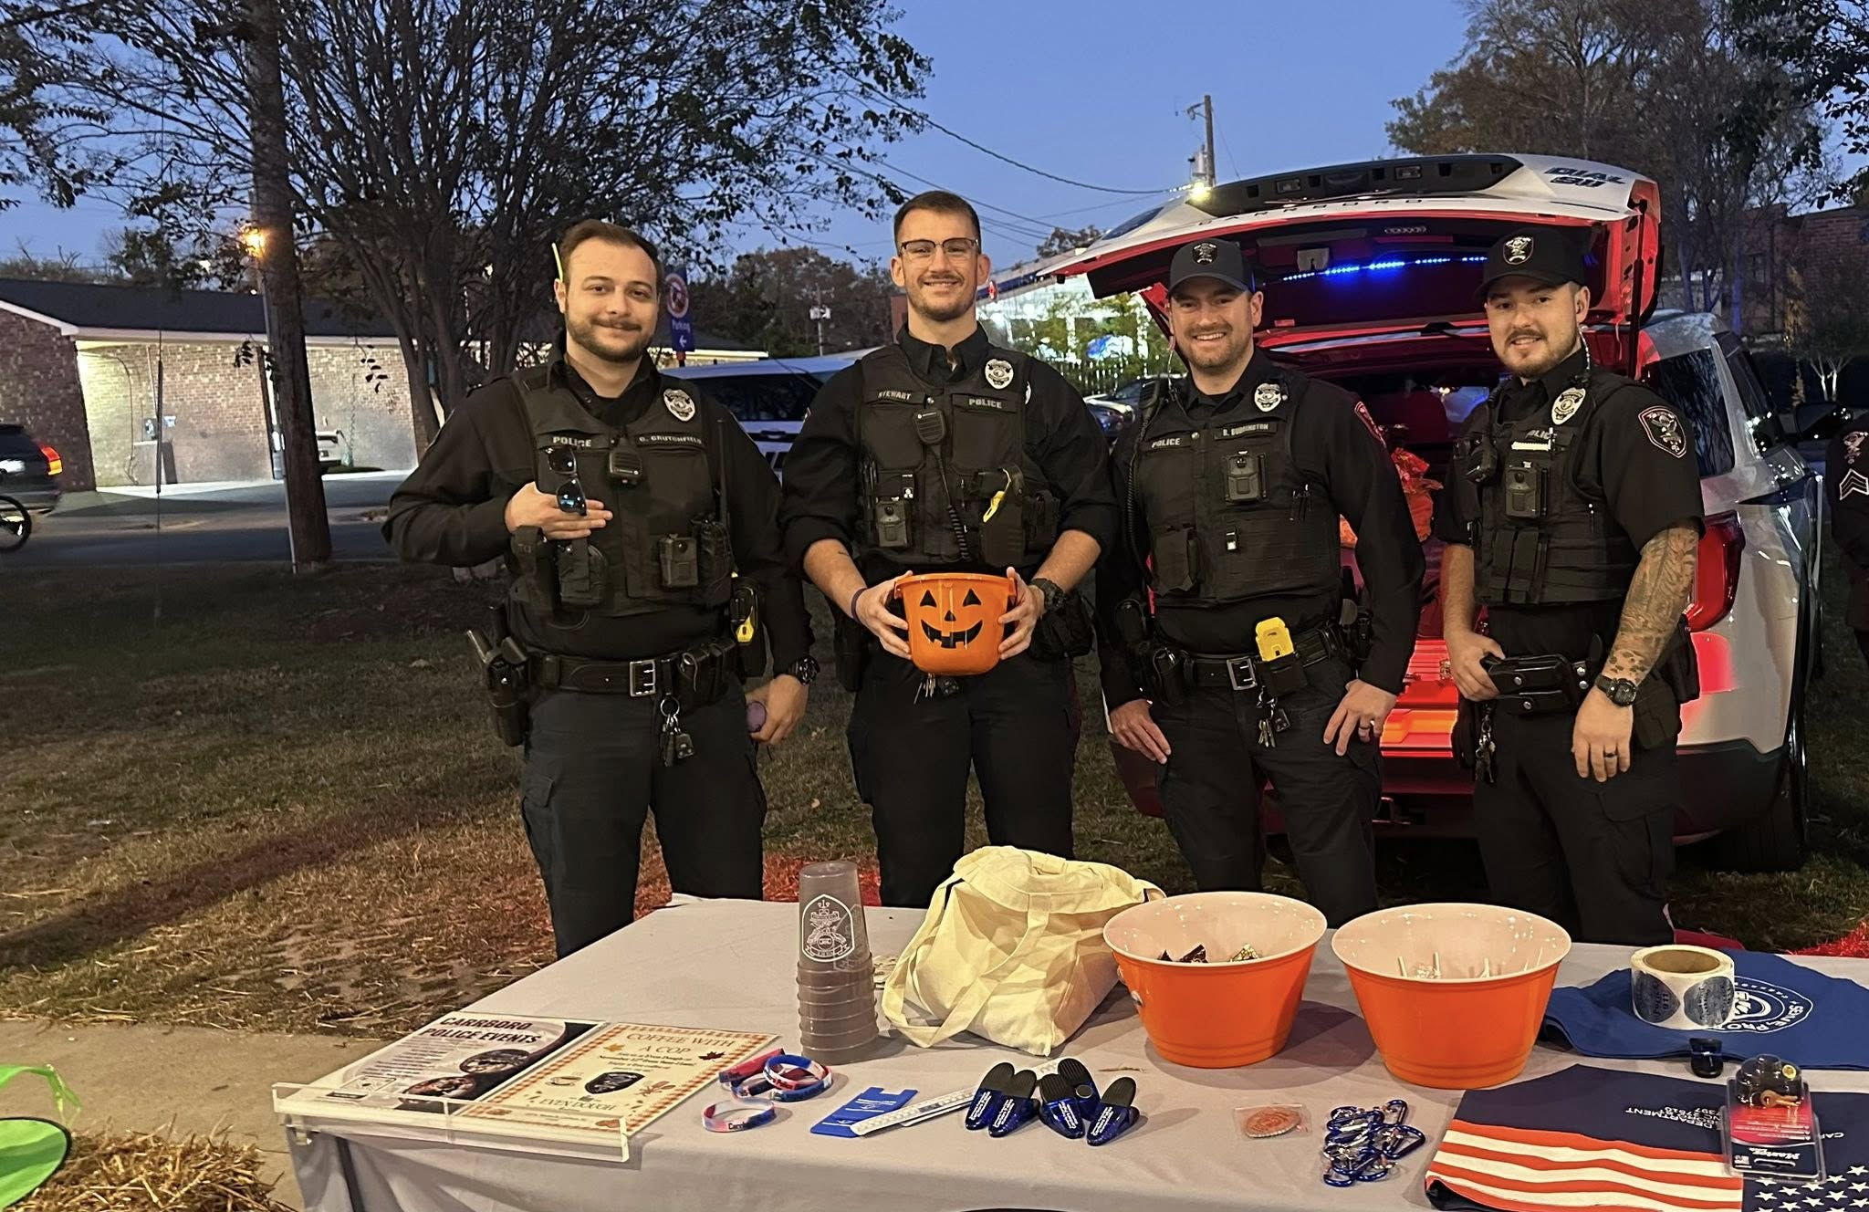
Police Department
Second social worker hired that works with Carrboro specific individuals, the CARE Team, and the Chapel Hill Crisis team.
CARE Team expansion into Carrboro in September.
Several programs were created including: Laundry Program, Triangle Bus Pass Program, Mental Health Mondays, and a Community Baby Shower. Future plans include mental health first aid training for town employees and community members.
Implemented a scannable Diversion/Deflection card that refers individuals to programs and community resources. Cards are scanned by officers and members of the public and information is received by a social worker. Social workers then reach out to referred person to provide resources and care.
Criminal Justice Debt Program assists Carrboro residents to help get driver’s licenses restored and court fees and costs paid off.
The police department sponsored or participated in 68 community events so far in 2025.
Center for Policing Equity partnership and evaluation ongoing.
Diversion and deflection in practice: approximately 30% of low-level criminal charges deflected approximately 50% of traffic stops for minor traffic offenses result in a warning and low-level drug misdemeanors are generally deflected

Slide 14
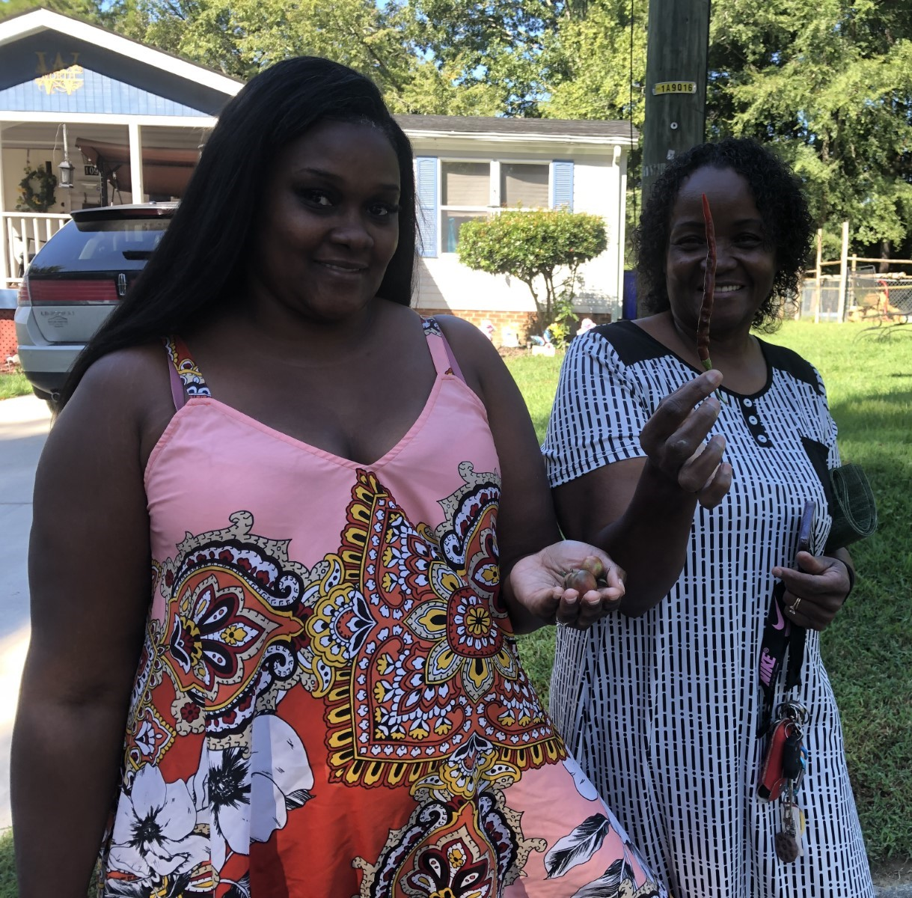
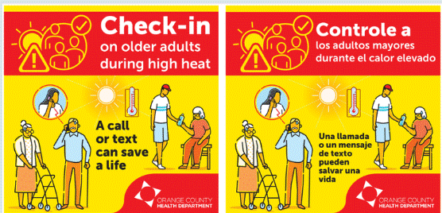
Climate Action
Green Neighborhood Grants - Awarded to 11 community groups to implement impactful climate action in their neighborhoods. Provide up to $2,500 to benefit low-income households and residents of color by bringing neighbors together to pursue projects which will reduce greenhouse gas emissions and create natural areas that are more resilient to the impacts of climate change.
Income Qualified Solarize Pilot
Carrboro’s new pilot program focuses on empowering low-to-moderate income households by providing them with free solar installations. These households often spend a significant portion of their income on energy costs.
Amanda worth and her daughter with produce grown in the garden
Orange County Heat Action Plan
The Orange County Heat Action Plan, being developed collaboratively by Orange County, Chapel Hill, Hillsborough, and Carrboro after the record-breaking heat during the summer of 2024, aims to coordinate heat mitigation, preparedness, adaptation, and response across the community. The plan includes three ambitious goals: Outreach and education to prepare and protect the public, Enhanced emergency response mechanisms, and Cool homes and neighborhoods.

Slide 15
Economic Development
Continues to incorporate equity in all of our work.
This past year we have:
begun the implementation of the Disparity Study, conducted a 4th Amendment Workshop for businesses (to train business owners of their rights in protecting their employees and customers from Federal search and seizures)
studying the implementation of a Living Wage program to promote and encourage businesses to pay a living wage in Carrboro, promoting BIPOC businesses during the Holiday shopping season with "Buy BIPOC" social media posts going out Thanksgiving through New Years
continuing to ensure staff visit BIPOC businesses to find better ways to support and encourage their success.

Slide 16
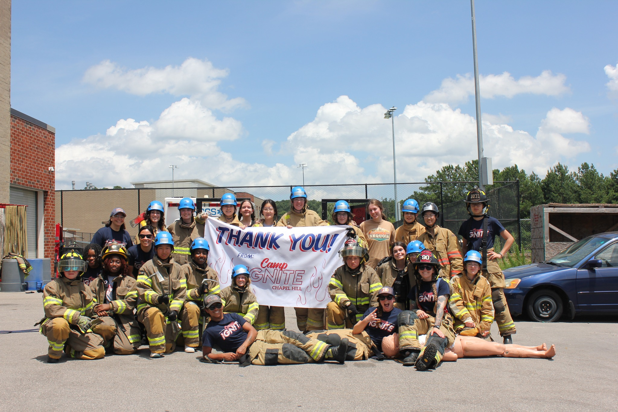
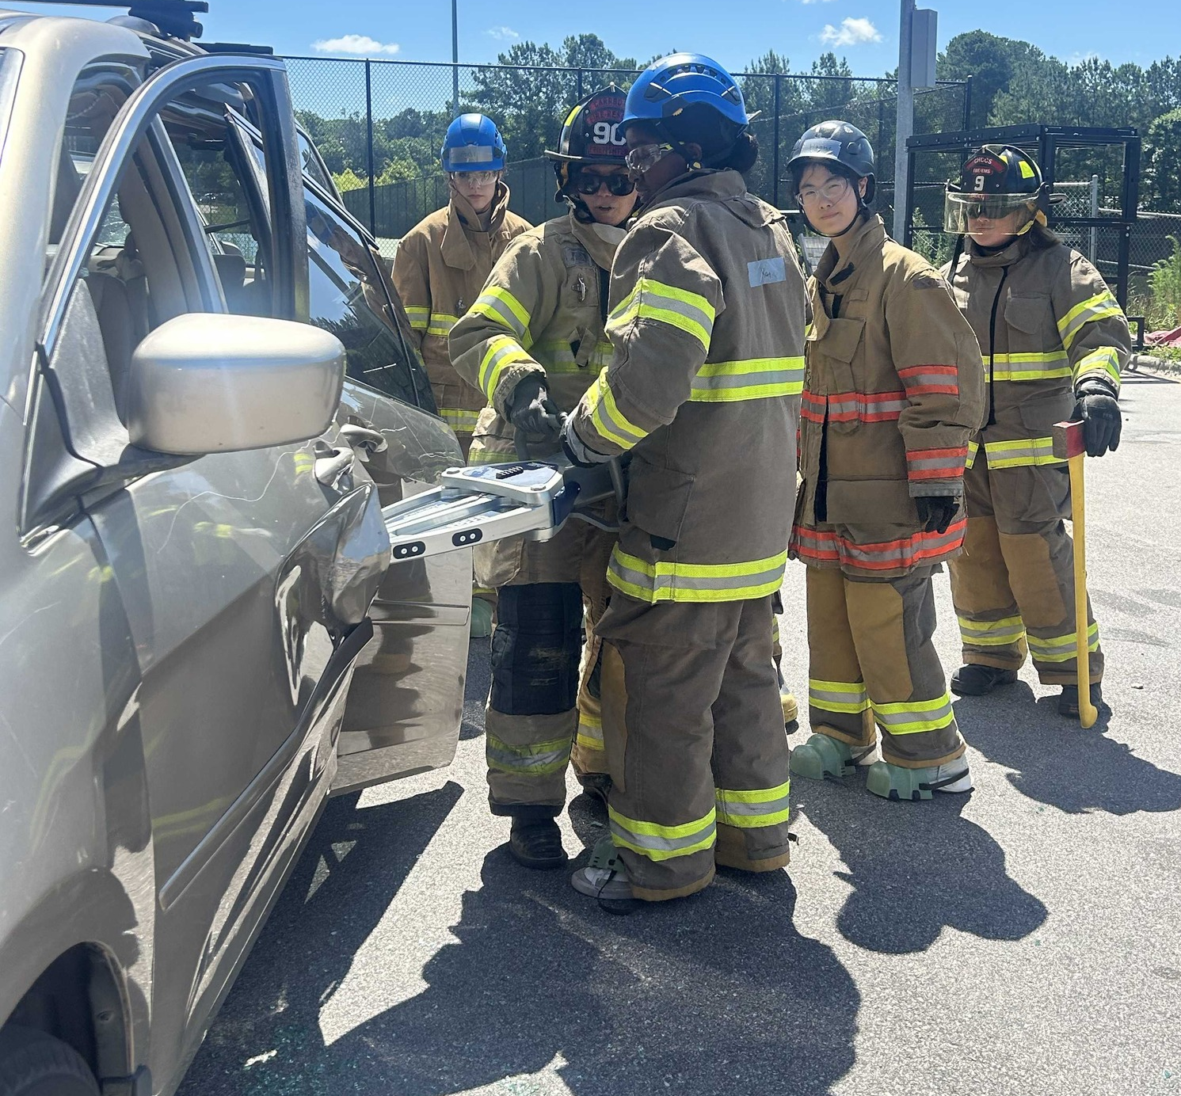
Fire-Rescue Department
Camp Ignite – Chapel Hill: Fostering Diversity and Future Talent - successfully co-hosted the fourth annual Camp Ignite – Chapel Hill in June 2025.
This summer camp for high school females was implemented through a partnership with the Chapel Hill High School (CHHS) Fire Academy and the Chapel Hill Fire Department (CHFD).
The program has demonstrated significant success in outreach, with approximately 65% of all camp attendees to date identifying as minorities.
The initiative has proven effective in cultivating interest in the fire service. Notably, two recent applicants for CFRD positions cited their participation in Camp Ignite and sustained engagement with the CHHS Fire Academy partnership as the interest in the department.
Planning for the fifth annual camp, scheduled for June 2026, is currently underway.

Slide 17
Fire-Rescue Department
Smoke Alarm Canvassing Program
The CFRD conducted three comprehensive smoke alarm canvasses targeting underserved areas of the community. This critical public safety initiative included: Testing and free installation of smoke alarms, Providing essential public education on proper smoke alarm testing and maintenance procedures, Multilingual staff and volunteers were utilized to improve the success of the program.
Commitment to Workforce Diversity
The organization achieved significant progress in its commitment to building a representative workforce, with 50% of all personnel hired in Calendar Year 2025 identifying as minorities.
Child Passenger Safety (CPS) Partnership
The CFRD received an award from Safe Kids Worldwide for its collaborative Child Passenger Safety project with El Centro. This vital partnership focuses on reducing risk for young children by providing comprehensive services, including:
Professional installation of child safety seats, Provision of free child safety seats to families demonstrating need, In-depth education on best practices for securing children in vehicles.

Slide 18
Town Manager’s Office
Municipal Equality Index, Carrboro received a score of 93 in the 2025 Municipal Equality Index.
Embedding Equity in Service Delivery
Departments are actively using the Racial Equity Assessment Lens (REAL) to review policies, practices, services, and new initiatives. Departments completed 19 Racial Equity Assessment Lens this year.
The Pocket Question Practice was reviewed and enhanced this year with the addition of Climate Action questions, developed by the Town Manager’s Office intern. Departmental responses help inform Town Council decisions.
CORE Team members continue reviewing departmental REALs and providing recommendations.
Departmental listening sessions were completed to gather staff insights, experiences, and feedback related to the Town’s race and equity efforts. The information collected can inform future support structures, training priorities, and professional development opportunities.
Earlier this year, the town began partnering with the Center for Policing Equity to analyze the Town’s policing data for potential data gaps, deficiencies, and remedies. In its initial work scope, the CPE engaged in a Data Gap Analysis, in which the various data points collected by the Carrboro Police Department during daily operations were collected and analyzed for ‘missing’ or incomplete variables compared for ‘data completeness’ against the total variables the CPE looks for, such as demographic information on officers, location data, and call type. Key findings surfaced with recommendations for closing gaps. Most recommendations overall emphasize adding more detail to reports, such as specific types of physical force used, adding a Mental Health Indicator to calls, and improving technologies to enhance possible detail.
The Town holds the second highest % in Use of Force Data Completion among all CPE partners (86%)
The Town holds the highest % in Vehicle Stops Data Completion among all CPE partners (93%)

Slide 19

Town Manager’s Office
Training, Professional Development and Other Opportunities
Town staff engaged in training opportunities and earned certifications through GARE, Race Forward, the Color of Education Summit, Academy to Innovate HR, and Siembra NC.
Carrboro was selected to participate in GARE’s Jurisdiction Evaluation Learning Exchange, joining 24 jurisdictions. Hosted by GARE, Ubuntu Research and Evaluation, Clear Impact, and Equal Measure, this year-long exchange focused on evaluation learning, tracking racial equity progress, and developing a framework for jurisdictions to use beginning in 2026.
Carrboro’s Community Voices Series, Each month, employees gather to listen, learn, and connect with community organizations, businesses, and residents who share their stories, community impact, partnership opportunities, and ideas for building a stronger community together.
Carrboro Rise is a 10-week program launched in 2025, in partnership with Carrboro High School, to introduce students to the inner workings of local government. Each week, department heads from across the organization visited the class to share insights about their roles, responsibilities, and career paths. Students participated in informational sessions paired with hands-on, engaging activities designed to deepen their understanding of public service..
Racial Equity Commission Work
Continue reviewing departmental REALs and providing recommendations.
Tabled at the Carrboro-Chapel Hill Juneteenth Celebration.
Exploring opportunities for new Carrboro Truth Plaques.

Slide 20

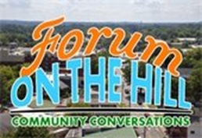
Town Manager’s Office
Leadership and Representation
The Mayor and staff provides leadership on the Executive Board of the Chapel Hill-Carrboro Branch of the NAACP and as Second Vice President.
Staff serves as a representative of the International City/County Management Association (ICMA) Equity Officer Cohort.
Staff appeared as a guest on WCHL’s “Forum on the Hill: Community Conversations” with Andrew Stuckey, throughout the year, a series dedicated to community issues related to diversity, equity, inclusion, and social justice. Community awareness, understanding, and allyship remain central themes.
Orange County Digital Opportunity Plan, Staff serves as Town representatives for the steering committee alongside the Central Pines Regional Council, Orange County staff and agencies, and local government partners.
Staff participated in GARE’s nine-month Inaugural Southern Innovation Community, alongside practitioners from North Carolina, Florida, and Texas. The cohort explored key insights, lessons, and strategies for advancing racial equity in government and developed new tool - Southern Strategies Playbook
Staff contributed a written reflection, “How to Build a Path for People to Follow,” published on the GARE blog in January.
Presentation to the Orange County Communicators Work Group, Race and Equity Team joined the Communications and Engagement Department to present “Sharing Ideas for Inclusive Community Engagement” a working outline for a community engagement plan.
The Race and Equity Office partnered with Alpha Kappa Alpha Sorority, Incorporated to host a community event promoting mental health awareness and supporting practices of collective care. Over 50 members of the community participated.

Slide 21
Thank You to Each Department and all Staff for all that you do!

