Slide 1
Policing Equity in Carrboro 2020 Q3
Update on efforts towards bias free policing

Slide 2
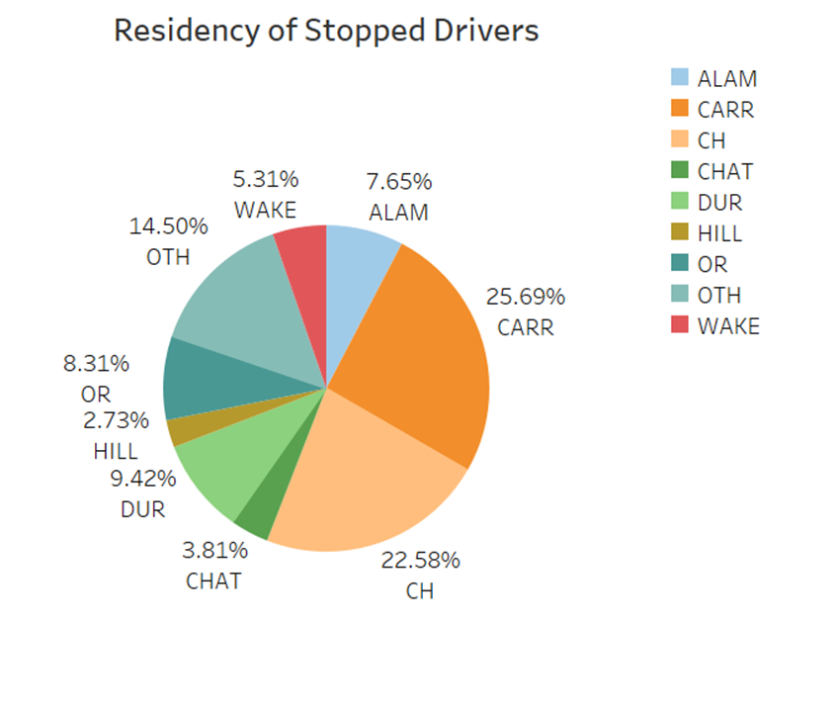
Residency Tracking 2019
Weighted Population
White 62.49037
Black 18.36172
Asian 7.39882
Hispanic 8.96115
Other 2.78794
The above chart is the estimated demographics of Carrboro drivers, based on area of residence of stopped drivers.
Notes:
We continue to track the place of residence of those stopped for traffic violations in Carrboro. Based on this, we see that we cannot compare demographics of all traffic stops to that of the town. While there is no perfect population to compare against, we believe that the weighted population offered is a better model for the demographics of those driving in Carrboro than the town population. Here, the residence status of all drivers stopped in 2019 is shown to give us a better comparison for the 2020 data.

Slide 3
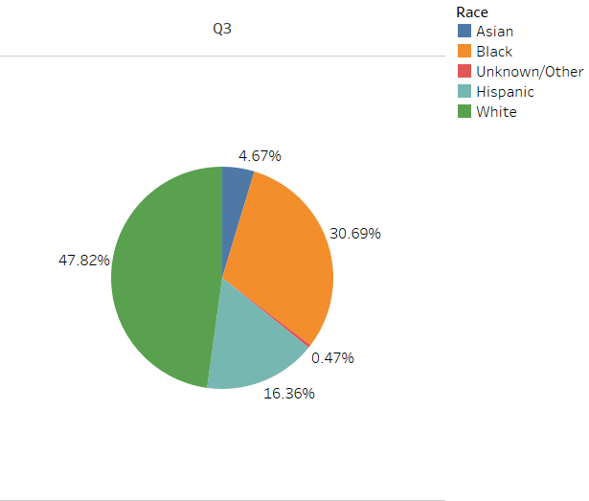
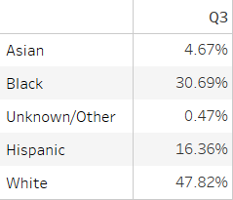
Overall Stop Rate 2020 Q3

Slide 4
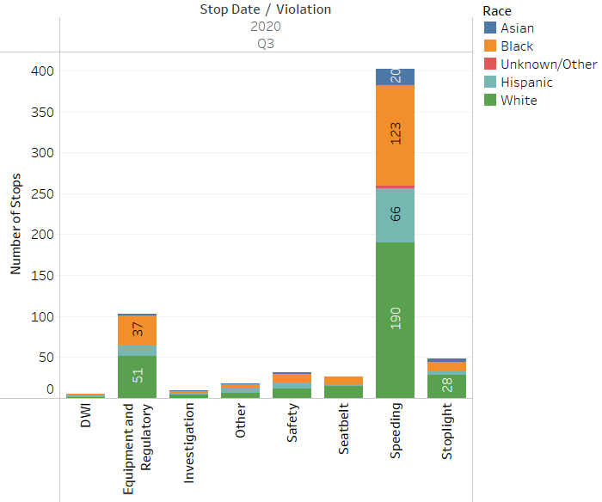
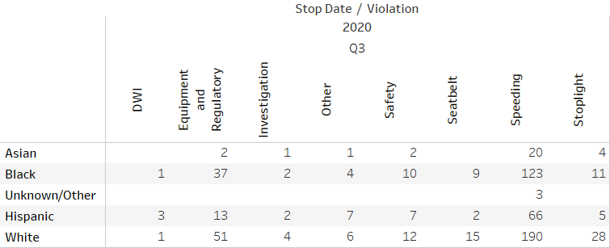
Reason for Stop
Notes:
This slide shows the five year comparison of the reason for stop. On our Traffic Stop report the reason for stop are Checkpoint, DWI, Investigation, Other MV violation, Safe Movement, Seat belt, Speeding, Stoplight/Sign, Equipment and regulatory , which we combined.
Note we only participate in DWI checkpoints hosted by other agencies outside of Carrboro. The last one we participated in was in 2016
Speeding is the most frequent reason for stops followed by equipment and regulatory.

Slide 5
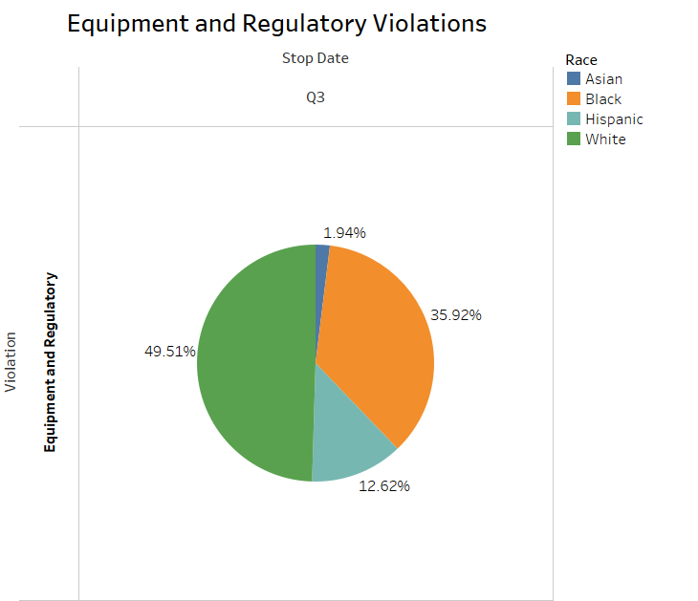
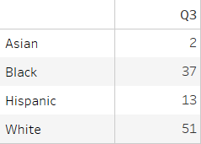
Equipment and Regulatory Violations
Notes:
One area we were trying to focus on was equipment and regulatory stops not being a priority. A Directive was issued in December of 2015, advising officers that these violations are not priority and to warn if possible.
On this slide, Note that while the NUMBER of stops overall went down after the directive, the PERCENTAGE of those stops went up for black people.
I don’t have an explanation for the increase for blacks. There could be other factors we are not aware of.
I will say that it is not because officers are profiling. I have full faith in my officers that they are policing correctly.

Slide 6
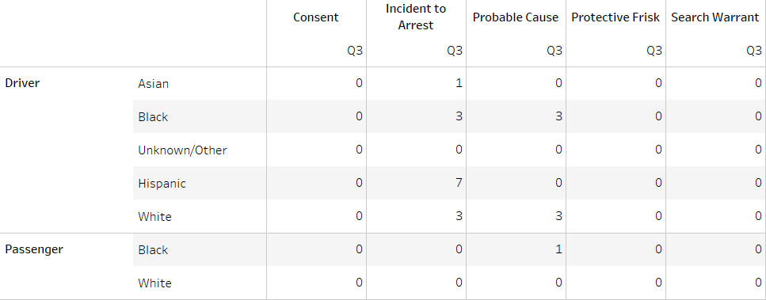
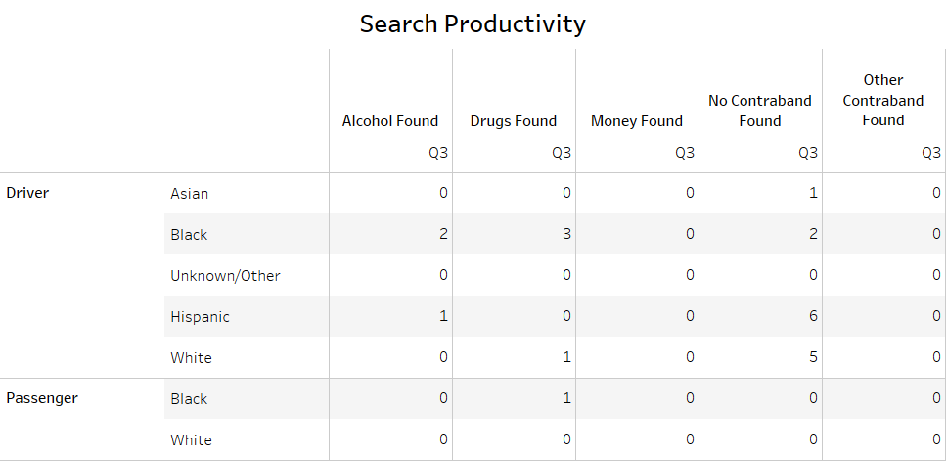
Types of Searches and Search Productivity
Notes:
Number of all search types; search productivity for all search types. Overall number of searches is very low, but we are concerned about the overall low productivity of searches.

Slide 7
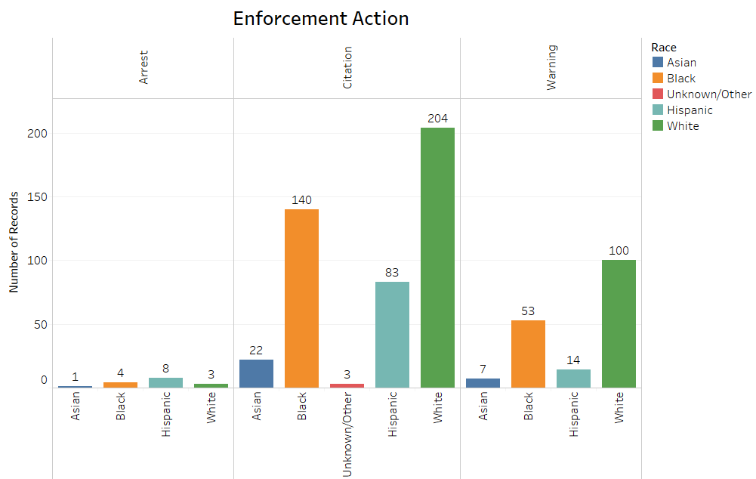
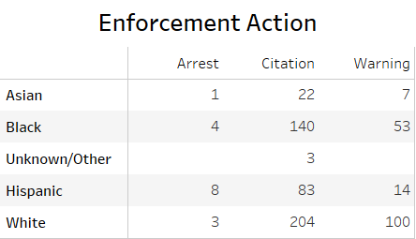
Enforcement Action 2020 Q3
Notes:
Enforcement action is where officers have the most discretion. There is a slightly elevated rate of citation for black drivers.

Slide 8
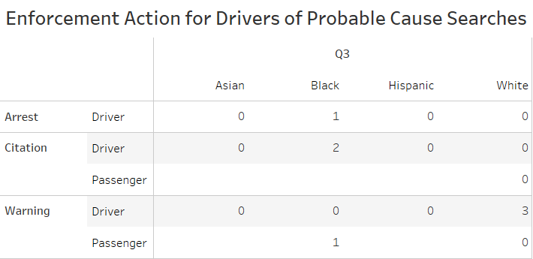
Probable Cause Searches
Notes:
Here is a break down of the enforcement action taken on probable cause searches

Slide 9
Use of Force
One use of force incident in 2020 Q3. Suspect involved was a Hispanic male.

Slide 10
Citizen Complaints
Only 1 citizen complaint in 2020 Q3.
Nature: Other; Resolution: Proper Conduct

